Slide 1
Harmonizing the EPD practice in the lighting industry
Dee Denteneer – Chair TF Ecopassport
Get Started

Slide 2
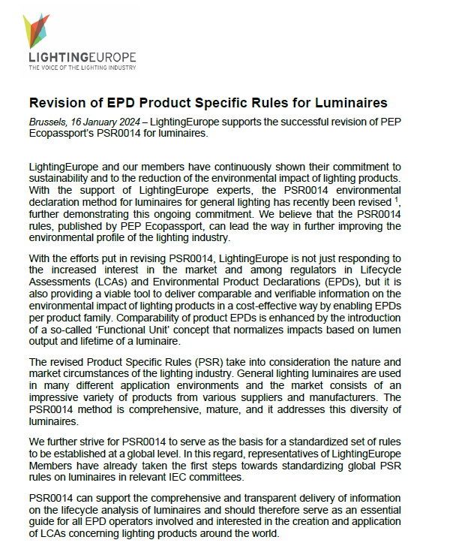
2

Slide 3
1
Background: A little quiz

Slide 4
Acronym Quiz: Entry Level
LCA
Who knows these acronyms?
EPD
4

Slide 5
Acronym Quiz: Entry Level
Life Cycle Assessment (LCA)
Compilation and evaluation of the inputs, outputs and the potential environmental impacts of a product system throughout its life cycle
LCA
Who knows these acronyms?
Environmental Product Declaration (EPD)
Providing verified and quantified environmental data using predetermined parameters and, where relevant, additional environmental information
EPD
5

Slide 6
Acronym Quiz: Intermediate Level
PCR
Who knows these acronyms?
PSR
6

Slide 7
Acronym Quiz: Intermediate Level
Product Category Rules (PCR)
A set of specific rules, requirements and guidelines for developing EPDs for one or more product categories
PCR
Who knows these acronyms?
Product Specific rules (PSR)
A set of specific rules, requirements and guidelines, based upon and complementing the PCR, for a specific product family
PSR
7

Slide 8
Acronym Quiz: Advanced Level
PEP
Who knows these acronyms?
PSR 0014
8

Slide 9
Acronym Quiz: Advanced Level
Product Environmental Profile (PEP)
P.E.P. Association develops international environmental declaration program for electronics
PEP
Who knows these acronyms?
Product Specific Rules (PSR) 0014
PSR number 14 “for luminaires” jointly developed by LightingEurope and the P.E.P. Association
PSR 0014
9

Slide 10
2
LightingEurope’s LCA Journey

Slide 11
Background
Product Category Rules
(PCR)
A set of specific rules, requirements and guidelines for developing EPDs for one or more product categories
Life Cycle Assessment
(LCA)
Compilation and evaluation of the inputs, outputs and the potential environmental impacts of a product system throughout its life cycle
Environmental Product Declaration
(EPD)
Providing quantified environmental data using predetermined parameters and, where relevant, additional environmental information
Product Specific rules
(PSR)
A set of specific rules, requirements and guidelines, based upon and complementing the PCR, for a specific product family
Identified concern: lack of harmonization of LCA/EPD practice in the lighting industry
To address: LightingEurope to support a harmonised LCA approach for lighting by joining PEP Ecopassport and participating in the review of the PEP PSR for luminaires
11

Slide 12
The revision process
Preparation
LCA training
Setting objective
Commenting
TF ecopassport started
Comment resolution
July 2022: face-to-face with PEP
LightingEurope joins PEP Association
Supported by external consultant
Finalization
Critical review
By experts in COTEC and external experts
March 2022-July 2022
July 2022-Sepember 2022
September 2022-December 2022
Endorsement by LightingEurope
with small team of experts to work with PEP
Comment resolution
February 2022 LightingEurope joins PEP Association
July 2022
F2F Meeting of LightingEurope delegates and PEP Association
January 2024
LightingEurope endorses PSR0014 Ed. 2.0
12

Slide 13
2
PSR0014 Deep dive

Slide 14
Deep Dive into PSR0014
Definitions & terminology in alignment with Ecodesign and IEC standards
Definition of the "functional unit" for luminaires
Consideration of lighting control scenarios and energy saving reductions
Homogeneous product families and extrapolation
14

Slide 15
Deep dive into PSR0014: definition of the "functional unit" (ISO14025) for luminaires
Functional Unit" (ISO14025) for luminaires:
“Provide lighting that delivers an outgoing artificial luminous flux of 1,000 lumens during a reference lifetime of 35,000 hours”
Definition of Functional Unit
Using the Functional Unit, the environmental impacts allow a fair comparison of luminaires of:
different luminous fluxes
different lifetimes
“Comparability of product EPDs is enhanced by the introduction of a so-called ‘Functional Unit’ concept that normalizes impacts based on lumen output and lifetime of a luminaire.“
15

Slide 16
Deep dive into PSR0014: Consideration of lighting control scenarios and energy saving reductions
Overview of light management functions, Including sensing and luminaire capable of communicating with an external lighting control system.
Harmonized approach for energy savings developed and implemented.
“EPDs can reflect the advantages of light management in a harmonized way”
16

Slide 17
Deep dive into PSR0014: Homogeneous product families and extrapolation
Definition of homogeneous product families
Specification of extrapolation rules
Extrapolation rules enable fast & cost-efficient generation of PEP EPDs declaration for a large product portfolio
“To deliver comparable and verifiable information on the environmental impact in a cost-effective way by enabling EPDs per product family.“
17

Slide 18
3
Conclusion & next steps

Slide 19
Next Steps: Technical Harmonization
Product specific rules for drivers and light sources
Product specific rules for emergency luminaires
IEC Standardization Track
19

Slide 20
Next Steps: Industry Alignment
External communication and promotion, Green Light Alliance, webinar
Training for members
Possible LE Guidelines or Software on PSR0014-ed2
20

Slide 21
Conclusion
The revised Product Specific Rules (PSR) take into consideration the nature and market circumstances of the lighting industry. …… The PSR0014 method is comprehensive, mature, and it addresses this diversity of luminaires.
We believe that the PSR0014 rules can lead the way in further improving the environmental profile of the lighting industry.
21

Slide 22
Q&A Session
22

Slide 23
THANK YOU
Elena.scaroni@lightingeurope.org
+32 474 73 04 46
www.lightingeurope.org
205 rue Belliard, 1040 Brussels, Belgium
Follow us :
23

